Slide 1
Domain Specific Architectures

Slide 2
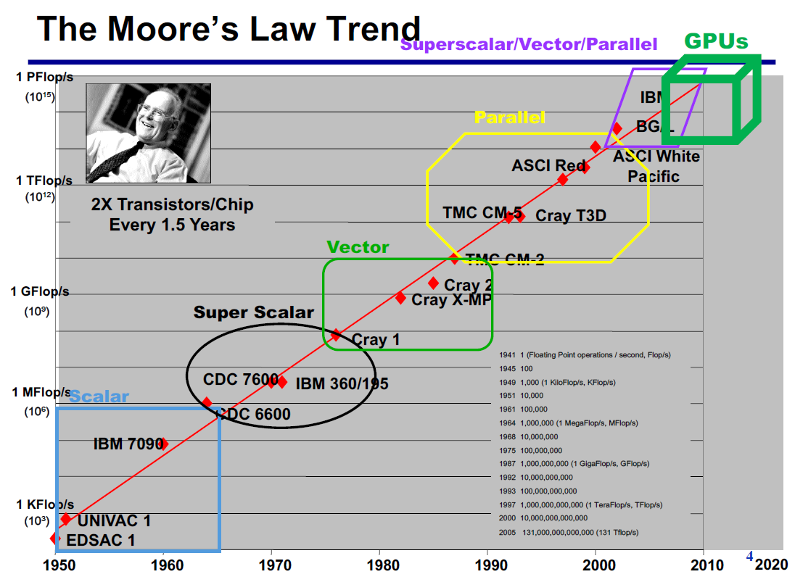
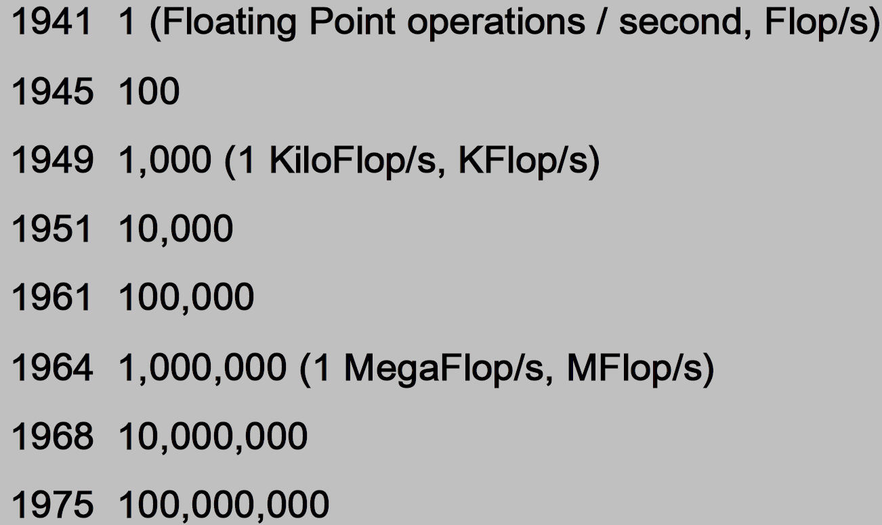

Slide 3
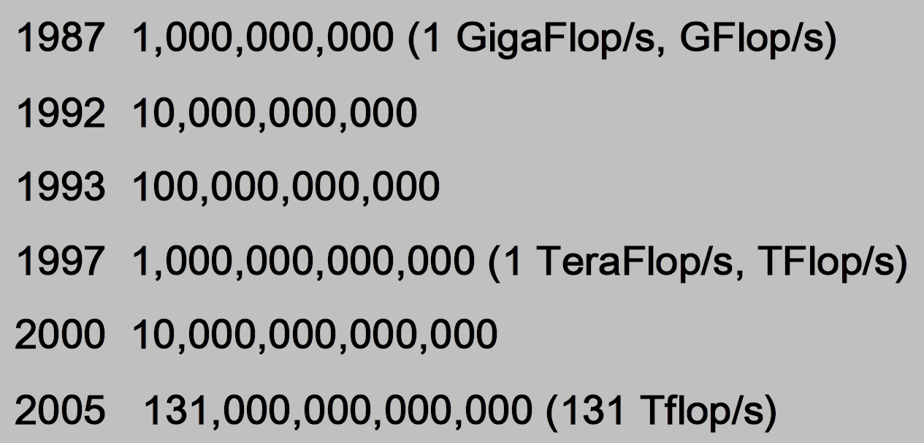

Slide 4
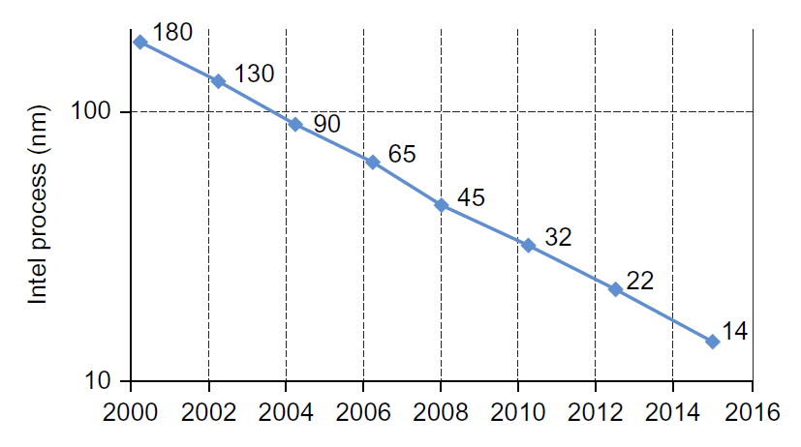
Moore’s Law trend
Moore’s Law enabled:
Deep memory hierarchy, e.g. 3- or even 4-level caches
Wide SIMD units, e.g. 512 bit SIMD register
Deep pipelines, e.g. 10-20 stages
Branch prediction, e.g. close to > 90% accurate rate
Out-of-order execution to achieve data-flow and remove
Speculative prefetching
Multithreading
Multiprocessing

Slide 5
The End of Traditional Scaling
Dennard Scaling has ended — transistor power density no longer decreases with size.
Moore’s Law is slowing — transistor doubling no longer yields proportional performance gains.
Consequence: General-purpose architectures face diminishing returns in performance, cost, and energy efficiency.

Slide 6
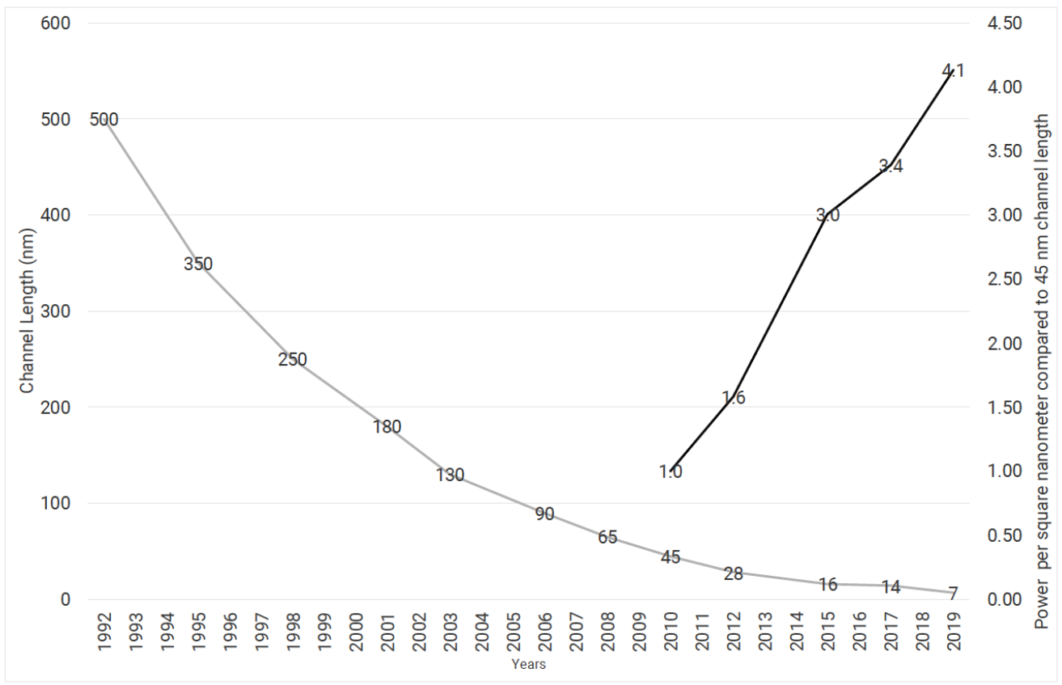
Semiconductor process technology

Slide 7
Limits of Traditional Performance Growth
Implementation technologies (like smaller process nodes) are near physical limits.
Parallelism — once the main path to higher performance — now faces scaling bottlenecks.
Increasing cores or threads gives less benefit per added resource.

Slide 8
The Shift Toward Domain Specific Architectures (DSAs)
DSAs propose a new paradigm for performance enhancement.
They focus on hardware acceleration for specific computational domains.
Belief: Major performance leaps now require domain-specific optimization, not generic architectures.

Slide 9
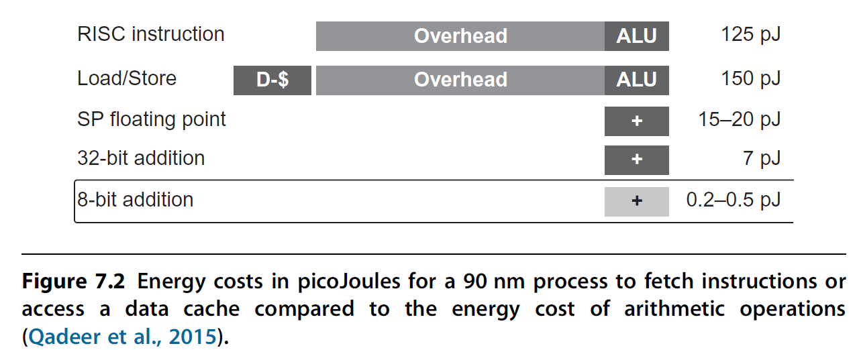
Why DSAs Matter
DSAs can dramatically improve performance for well-defined domains.
They offer energy efficiency by eliminating unnecessary general-purpose functionality.
They align hardware
capabilities directly
with application
characteristics.

Slide 10
Remembering Amdahl’s Law
Amdahl’s Law: The overall speedup from acceleration is limited by the fraction of time spent in the accelerated portion.
Implication: DSAs must target large portions of computation to meaningfully improve total performance.
Small accelerators for niche tasks yield minimal runtime benefit.

Slide 11
Power and Cost as Dominant Design Drivers
In large-scale computing (e.g., data centers), power consumption dominates cost and deployment decisions.
DSAs offer power-efficient computation, aligning with energy and thermal constraints.
The warehouse-scale computer environment amplifies these concerns — efficiency directly affects operational cost.

Slide 12
The Future of Performance Innovation
The era of “free” performance gains from transistor scaling is over.
Architectural specialization is now the main frontier for improvement.
DSAs will coexist with general-purpose CPUs, forming heterogeneous systems tailored to workload demands.

Slide 13
NRE Cost Comparison: ASICs, FPGAs, and DSAs
NRE refers to the one-time engineering cost to design, develop, and test new hardware.
Includes design effort, tooling, verification, mask generation, and fabrication setup.
Once paid, NRE does not recur for each produced unit — it’s a fixed upfront investment.
Critical factor when choosing between ASICs, FPGAs, and DSAs.

Slide 14
NRE in ASICs
Highest NRE cost among hardware options.
Involves full custom circuit design, mask creation, and fabrication setup.
Provides maximum performance and energy efficiency for a fixed function.
Economically viable only for high-volume production where costs can be amortized.
Modern ASIC tape-out can exceed tens of millions of dollars in NRE.

Slide 15
NRE in FPGAs
Very low NRE cost — no fabrication or mask costs; reconfigurable hardware.
Uses pre-fabricated logic blocks and programmable interconnects.
Ideal for prototyping, low-volume, or rapidly evolving applications.
Trade-offs: Lower performance and higher power consumption compared to ASICs.

Slide 16
NRE in DSAs
DSAs often fall between ASICs and FPGAs in NRE cost.
Built for specific domains (e.g., AI, graphics, data analytics).
NRE cost depends on design reuse, domain maturity, and manufacturing scale.
Benefit: Balance between specialization (like ASIC) and reuse (like FPGA).

Slide 17
ASICs vs. FPGAs vs. DSAs — NRE Trade-offs
Feature / Cost Factor | ASICs | FPGAs | DSAs
NRE Cost | Very High | Very Low | Moderate
Performance | Highest | Lowest | High (domain-optimized)
Energy Efficiency | Excellent | Poor–Moderate | High
Flexibility | None (fixed) | Full (reconfig.) | Limited (domain-specific)
Per-Unit Cost (at scale) | Lowest | Highest | Moderate
Time to Market | Long | Short | Medium

Slide 18
Guidelines for Domain Specific Architectures (DSAs)
Use dedicated memories to minimize distances of data movement
  Hardware-controlled multi-level cache
  domain-specific software controlled scratch-pad
Invest resources into more arithmetic units or bigger memories
  Core optimization (speculation, threading, etc), more domain-specific FU/memory
Use the easiest form of parallelism that matches the domain
  MIMD, SIMD or VLIW that matches domain
Reduce data size and type to the simplest needed for the domain
  General-purpose 32/64 integer/float; domain-specific 8/16 int/float
Use a domain-specific programming language to port code to the DSA
  General-purpose C/C++/Fortran
  Domain-specific language: Halide for vision processing, TensorFlow for DNN

Slide 19
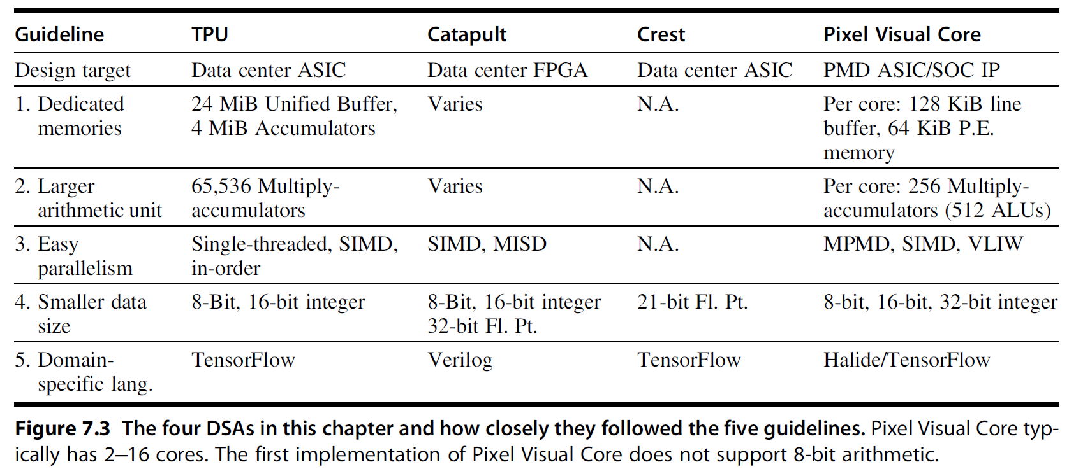

Slide 20
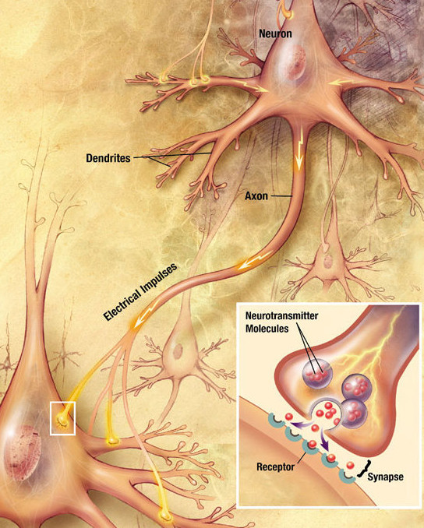
Example: Deep Neural Network
A Deep Neural Network (DNN) is a computational model inspired by the human brain’s structure and function.
It consists of multiple layers of interconnected nodes (neurons).
Each neuron applies a mathematical transformation to its input and passes the result to the next layer.
“Deep” refers to having multiple hidden layers between input and output.

Slide 21
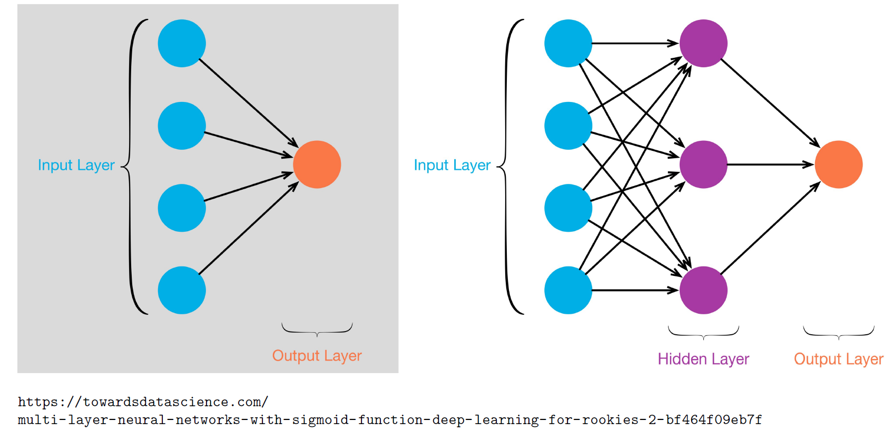
Multi-Layer Network

Slide 22
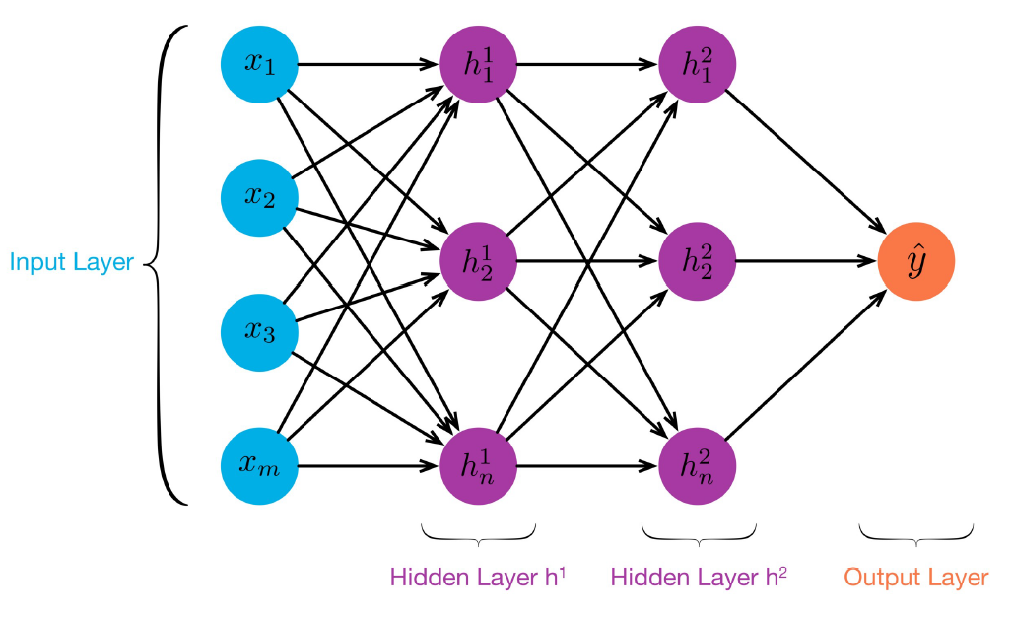
You can introduce as many hidden layers as you want.
Every time you add a hidden layer, you add a set of weights.

Slide 23
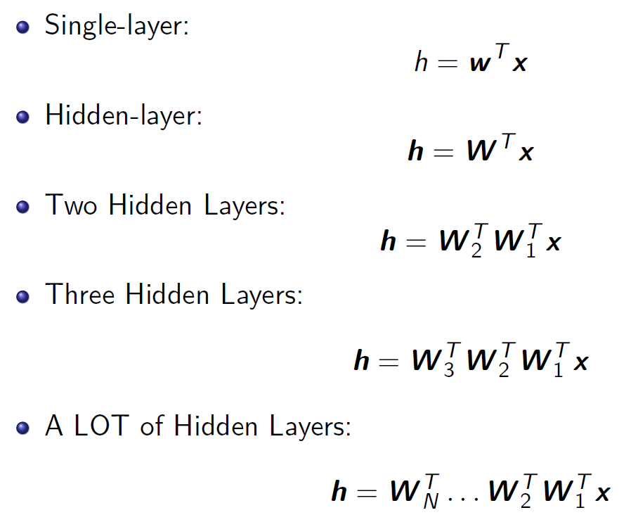

Slide 24
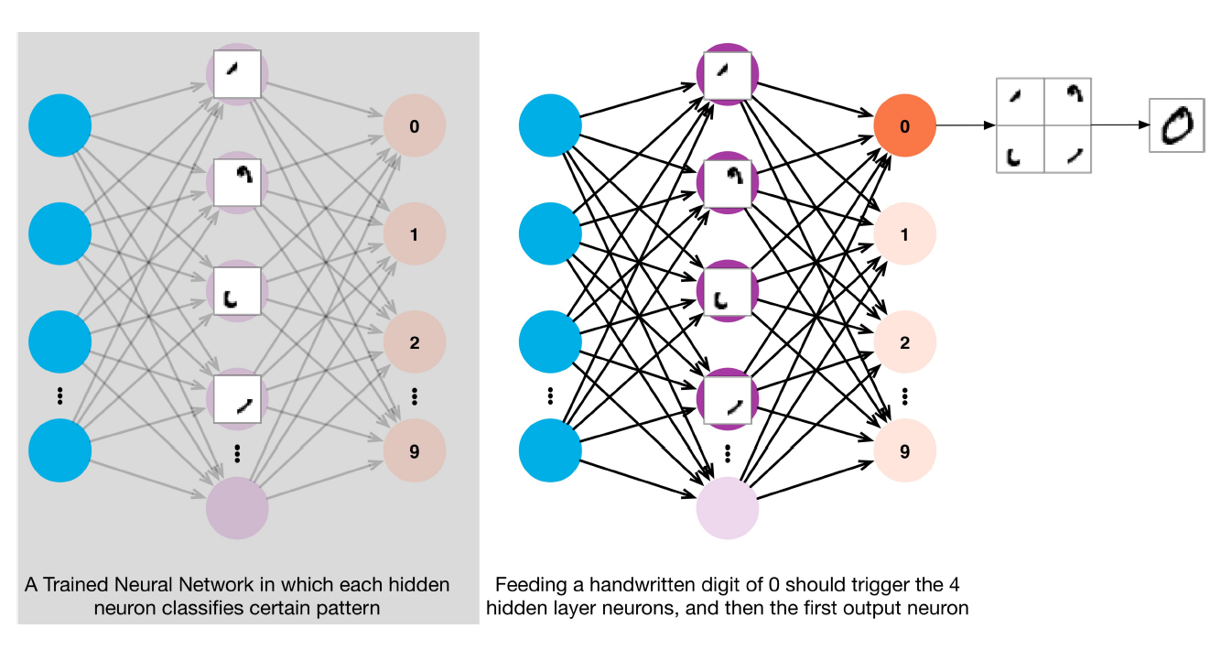
Interpreting the Hidden Layer
Each hidden neuron is responsible for certain features.
Given an object, the network identifies the most likely features.

Slide 25
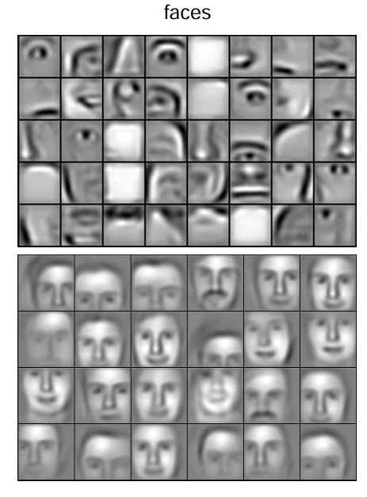
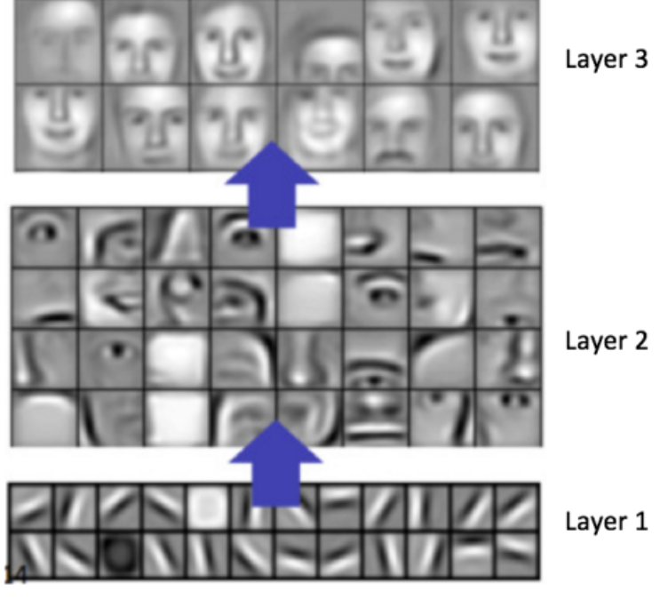
Interpreting the Hidden Layer contd…

Slide 26
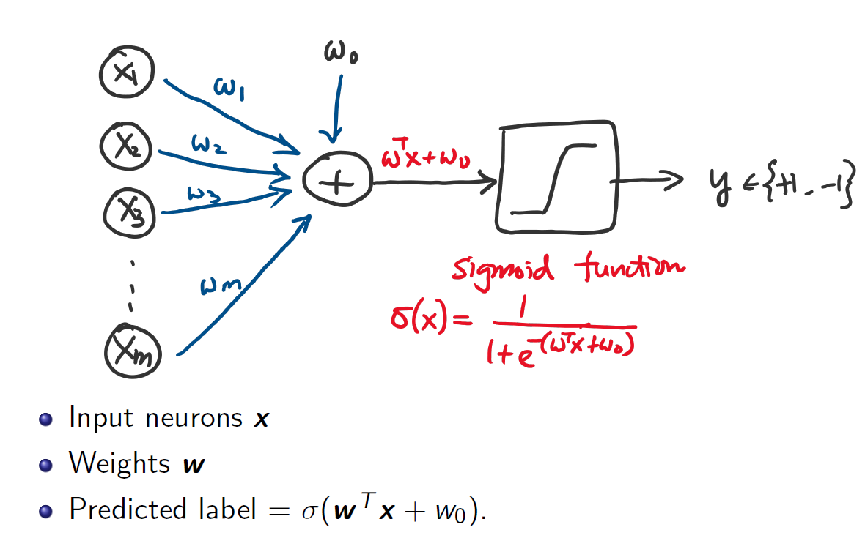
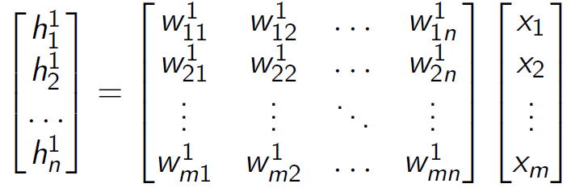
Single-Layer Perceptron

Slide 27
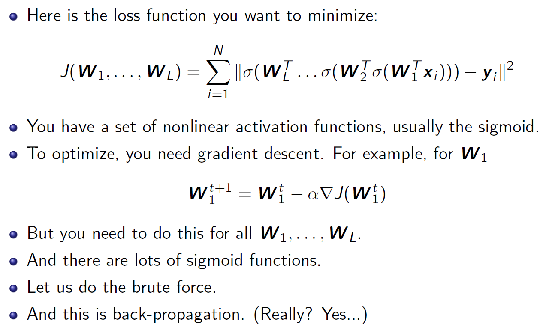
How do we efficiently learn the weights?

Slide 28
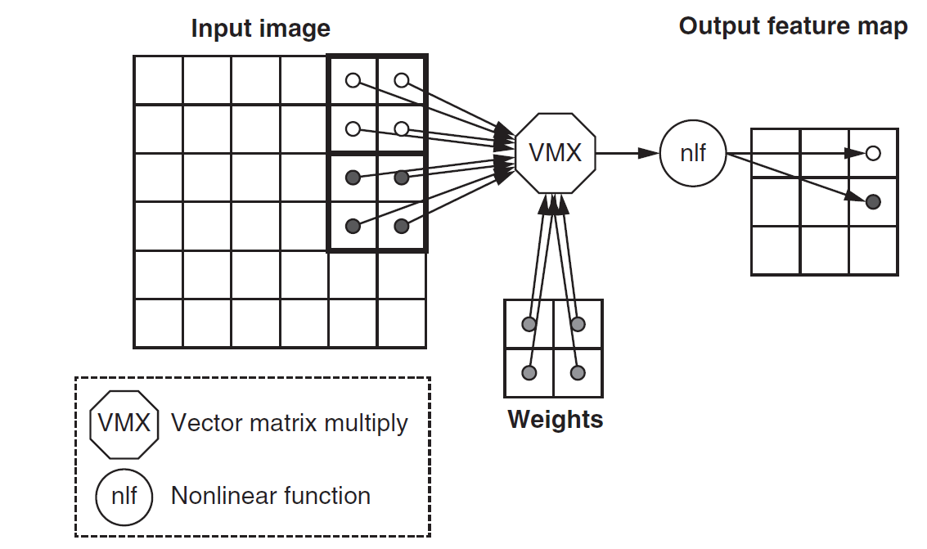
Convolutional Neural Network

Slide 29
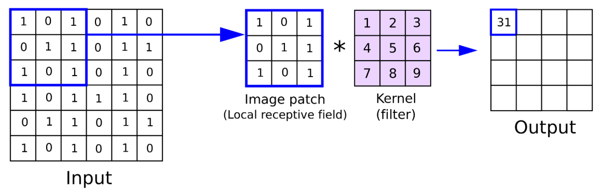

Slide 30
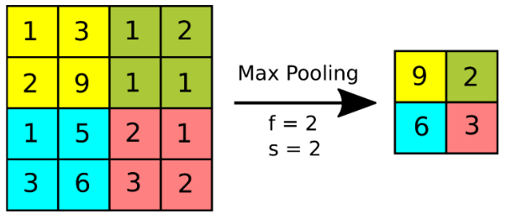
Max pooling layer

Slide 31
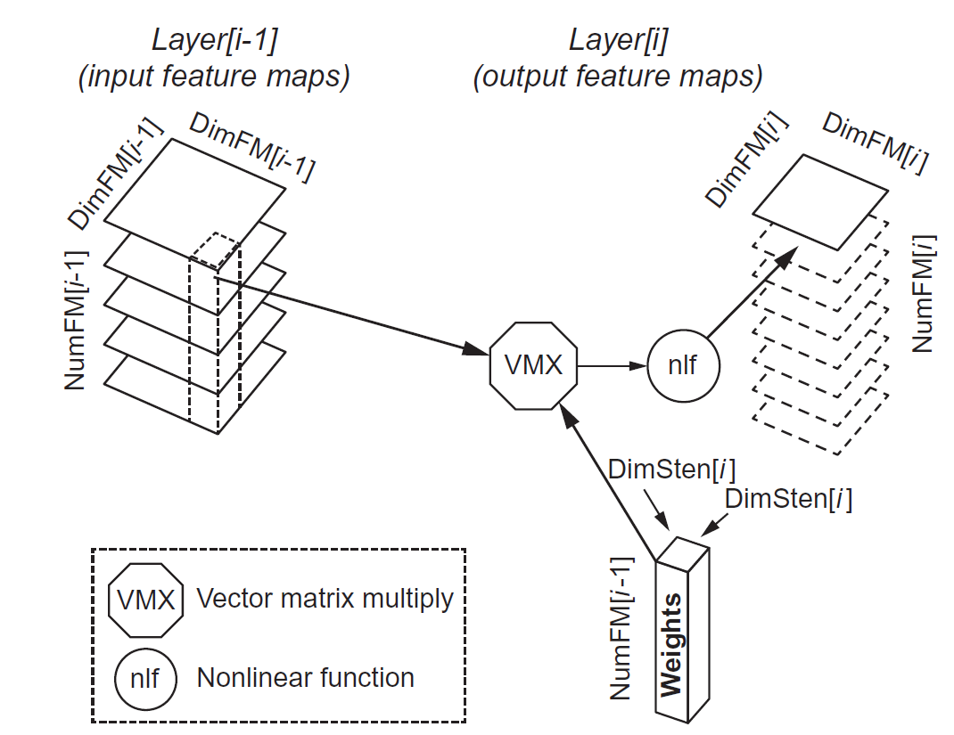
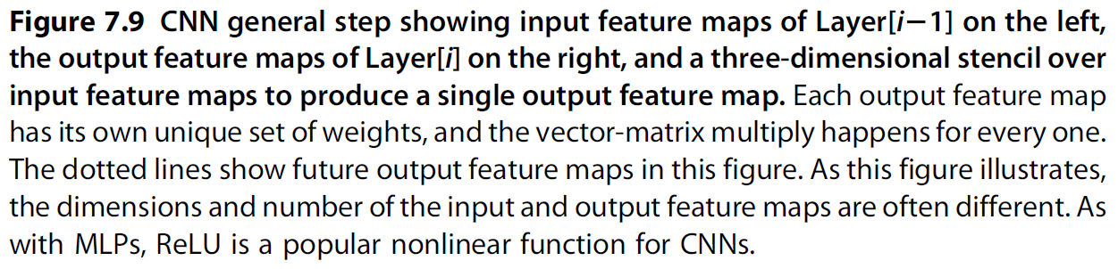

Slide 32
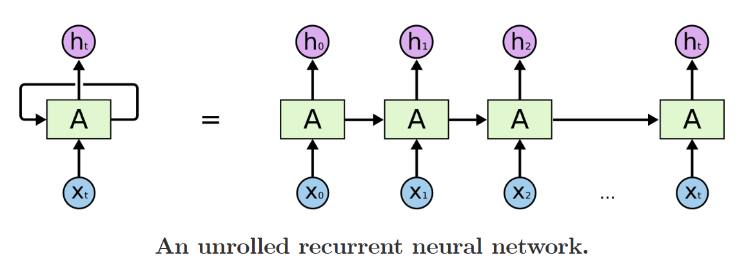
Recurrent Neural Network
A Recurrent Neural Network (RNN) is a type of neural network designed to process sequential data, where the order of the inputs matters.
Unlike standard (feedforward) neural networks, RNNs have feedback connections that allow information to persist across time steps.
The network receives one input at a time: example, one word in a sentence
It updates an internal hidden state that stores information about previous steps.
This hidden state is reused at the next time step, forming a recurrent loop.

Slide 33
A recurrent neural network can be thought of as multiple copies of the same network, each passing a message to a successor.
RNNs shown incredible success to a variety of problems: speech recognition, language modeling, translation, image captioning etc..
For example, consider a language model trying to predict the next word based on the previous ones. If we are trying to predict the last word in “the clouds are in the sky,” we don’t need any further context – it’s pretty obvious the next word is going to be sky. In such cases, where the gap between the relevant information and the place that it’s needed is small, RNNs can learn to use the past information.

Slide 34
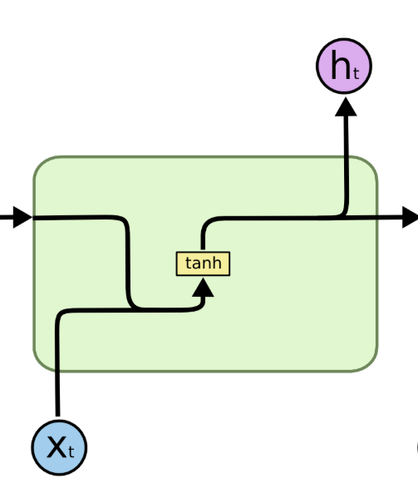
But there are also cases where we need more context. Consider trying to predict the last word in the text “I grew up in France… I speak fluent French.”
Recent information suggests that the next word is probably the name of a language, but if we want to narrow down which language, we need the context of France, from further back. It’s entirely possible for the gap between the relevant information and the point where it is needed to become very large.
Unfortunately, as that gap grows, RNNs become unable to learn to connect the information.

Slide 35
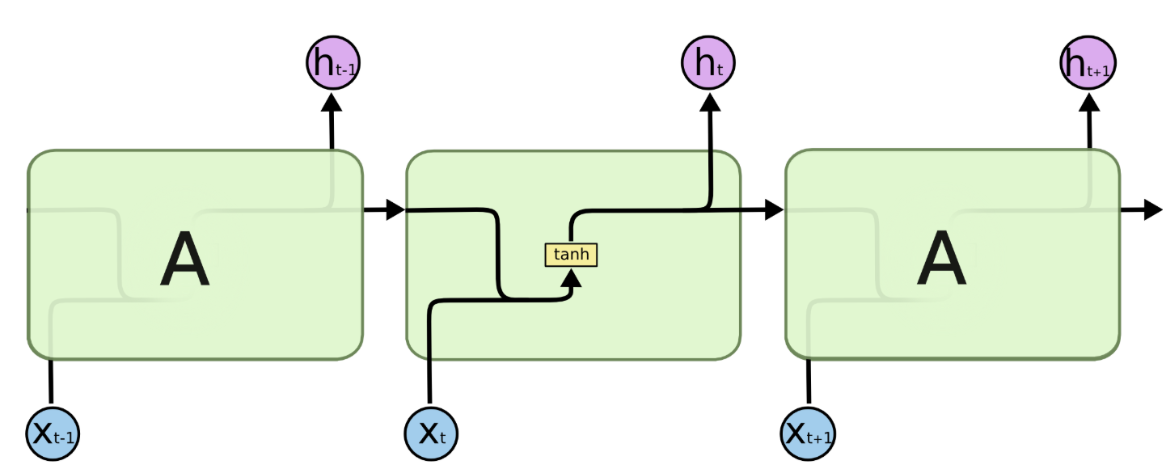
RNN model

Slide 36
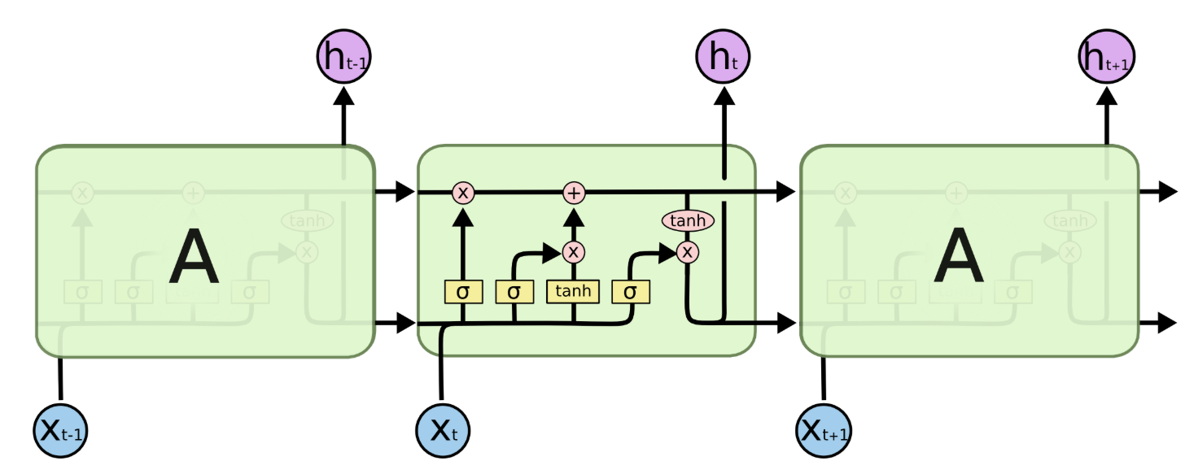
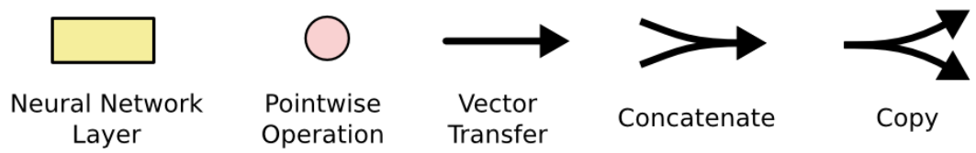
LSTM cell
Credit: https://colah.github.io/posts/2015-08-Understanding-LSTMs/

Slide 37
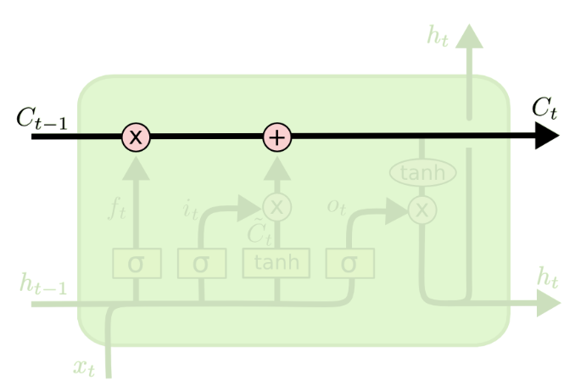
LSTM contd..
Long Short Term Memory networks – usually just called “LSTMs” – are a special kind of RNN, capable of learning long-term dependencies. They were introduced by Hochreiter & Schmidhuber (1997).

Slide 38
LSTM contd..
The key to LSTMs is the cell state, the horizontal line running through the top of the diagram.
The cell state is kind of like a conveyor belt.
It runs straight down the entire chain, with only some minor linear interactions.
It’s very easy for information to just flow along it unchanged.
The LSTM does have the ability to remove or add information to the cell state, carefully regulated by structures called gates.

Slide 39
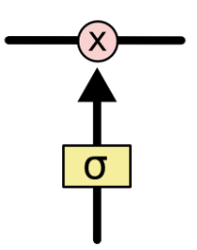
Gates in LSTM cell
Gates are a way to optionally let information through. They are composed out of a sigmoid neural net layer and a pointwise multiplication operation.
The sigmoid layer outputs numbers between zero and one, describing how much of each component should be let through. A value of zero means “let nothing through,” while a value of one means “let everything through!”

Slide 40
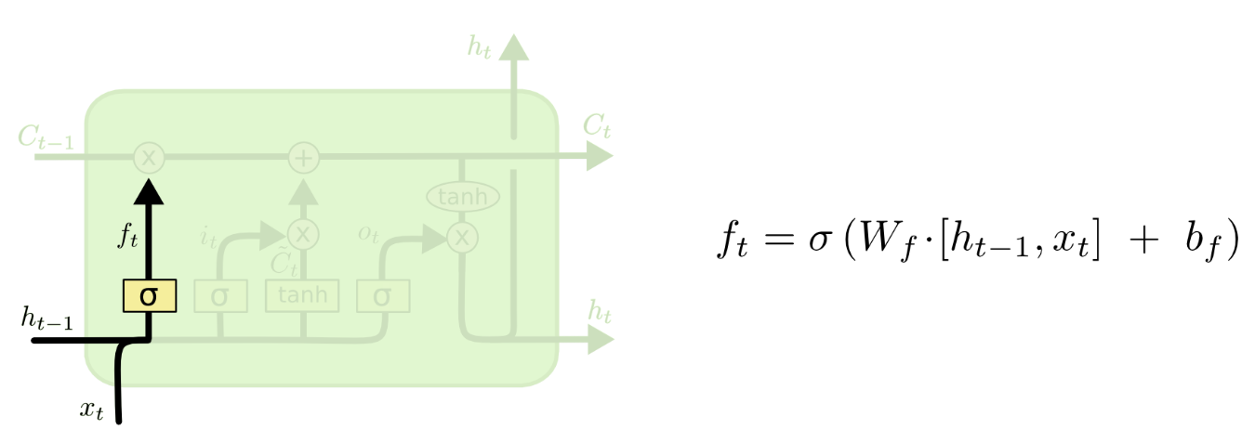
Forget gate
The first step in our LSTM is to decide what information we’re going to throw away from the cell state. This decision is made by a sigmoid layer called the “forget gate layer.”
It looks at h_{t−1} and x_{t}, and outputs a number between 0 and 1 for each number in the cell state C_{t−1}.

Slide 41
Forget gate
Gate output ‘1’ represents “completely keep this” while a ‘0’ represents “completely get rid of this.”
For language translation: The cell state might include the gender of the present subject, so that the correct pronouns can be used. When we see a new subject, we want to forget the gender of the old subject.

Slide 42

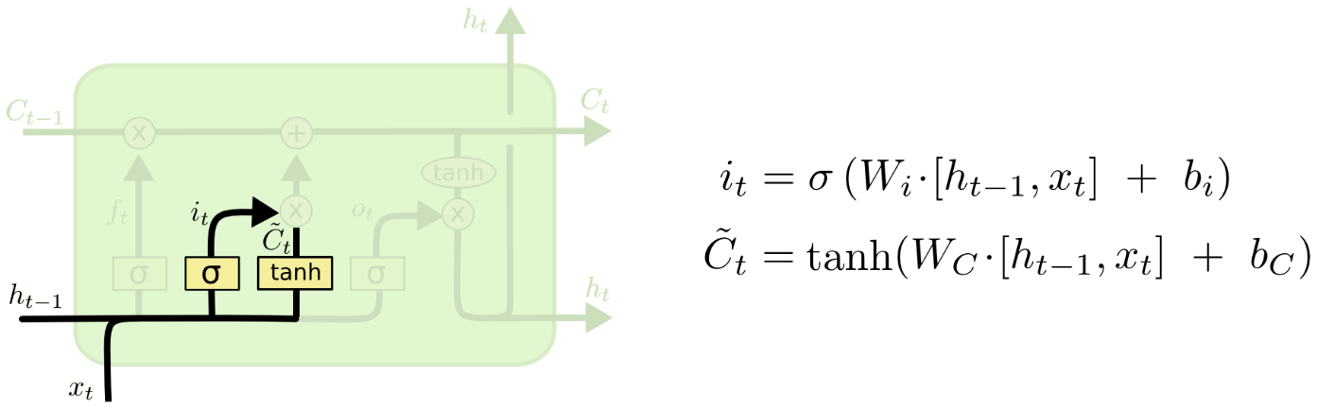
Input Gate
The next step is to decide what new information we’re going to store in the cell state.
This has two parts. First, a sigmoid layer called the “input gate layer” decides which values we’ll update. Next, a tanh layer creates a vector of new candidate values, C_{t}, that could be added to the state. In the next step, we’ll combine these two to create an update to the state.
In the example of our language model, we’d want to add the gender of the new subject to the cell state, to replace the old one we’re forgetting.

Slide 43
Input Gate

Slide 44
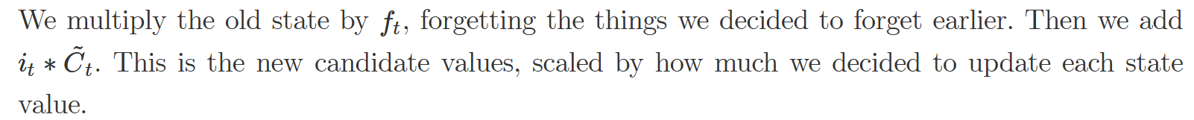
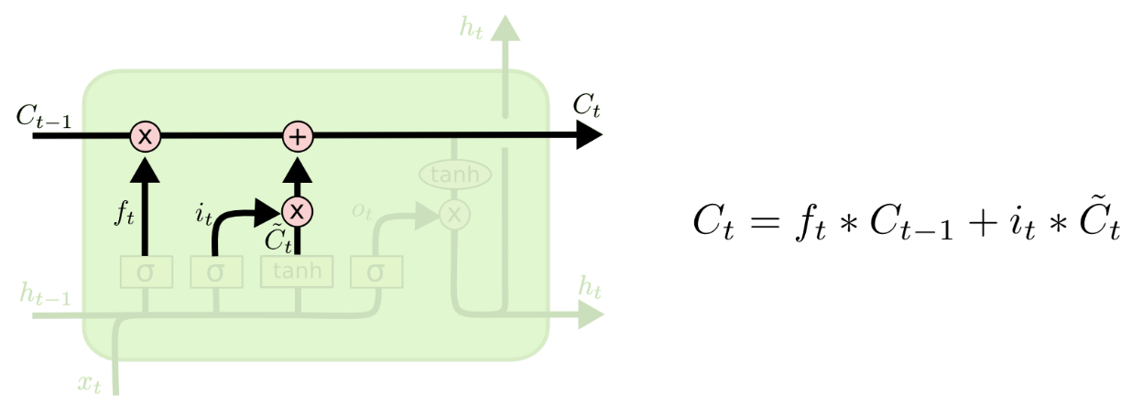
Update Cell Sate
Now it’s now time to update the old cell state, C_{t−1}, into the new cell state C_{t}.
The previous steps already decided what to do, we just need to actually do it.

Slide 45
In the case of the language model, this is where we’d actually drop the information about the old subject’s gender and add the new information, as we decided in the previous steps.

Slide 46
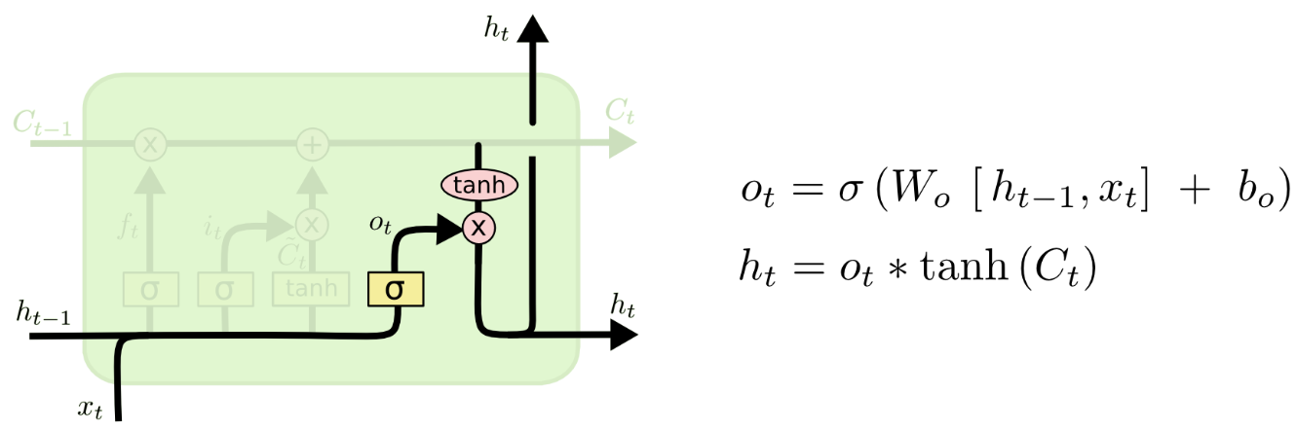
Outpt Gate
Finally, we need to decide what we’re going to output. This output will be based on our cell state, but will be a filtered version. First, we run a sigmoid layer which decides what parts of the cell state we’re going to output.
Then, we put the cell state through
tanh (to push the values to be between −1 and 1) and multiply it by the output of the sigmoid gate, so that we only output the parts we decided to.

Slide 47
Outpt Gate
For the language model example, since it just saw a subject, it might want to output information relevant to a verb, in case that’s what is coming next. For example, it might output whether the subject is singular or plural, so that we know what form a verb should be conjugated into if that’s what follows next.
tanh (to push the values to be between −1 and 1) and multiply it by the output of the sigmoid gate, so that we only output the parts we decided to.

Slide 48
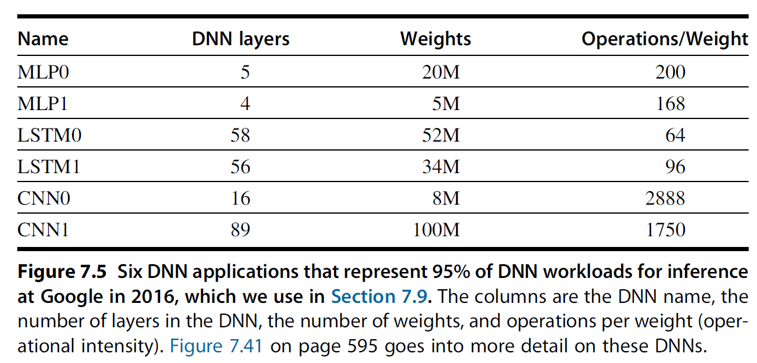

Slide 49
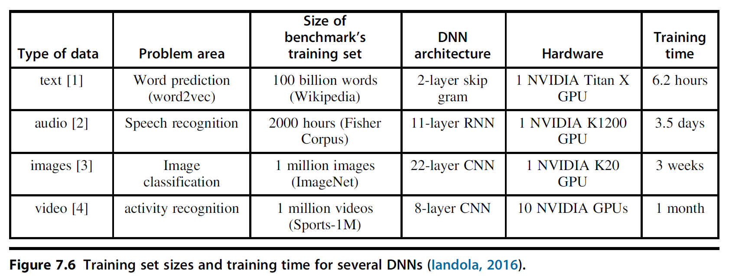
Training Versus Inference

Slide 50
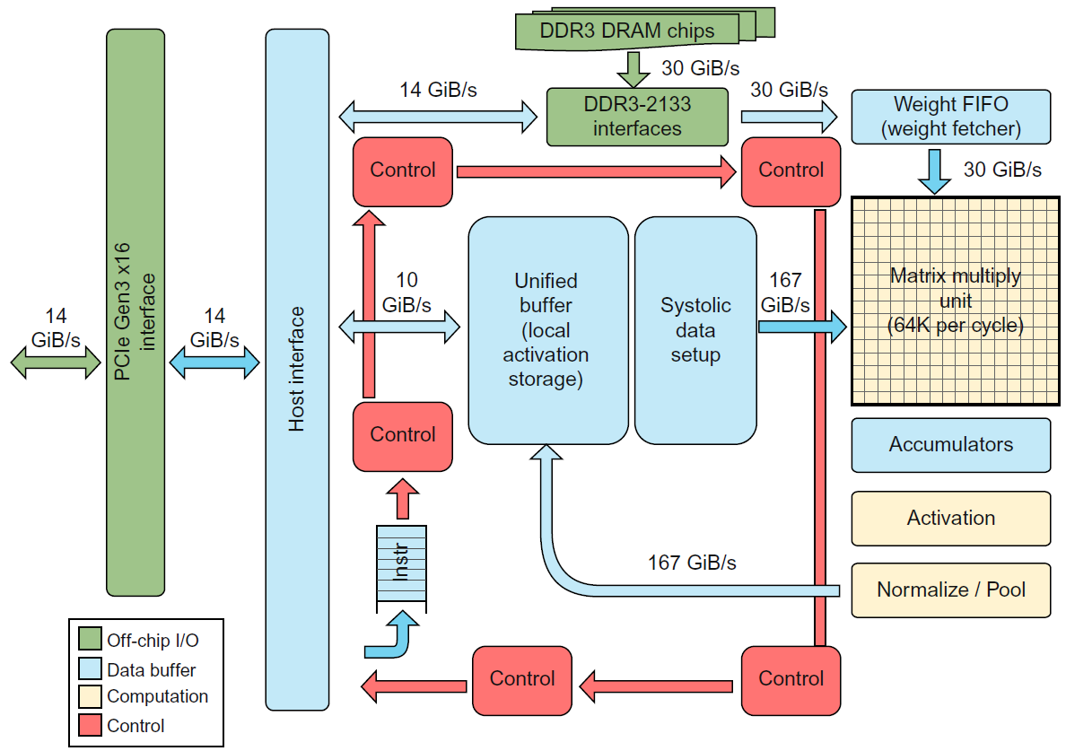
Google TPU
Fig: TPU Block Diagram. The PCIe bus is Gen3 16. The main computation part is the light-shaded Matrix Multiply Unit in the upper-right corner. Its inputs are the medium-shaded Weight FIFO and the medium-shaded Unified Buffer and its output is the medium-shaded Accumulators.

Slide 51
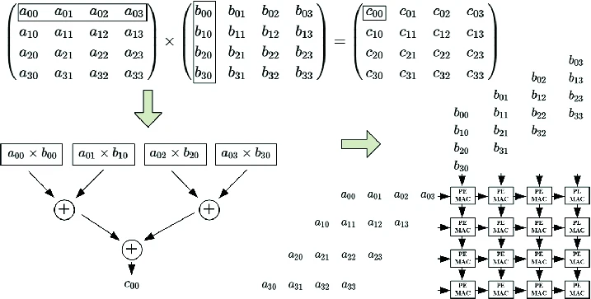

Slide 52
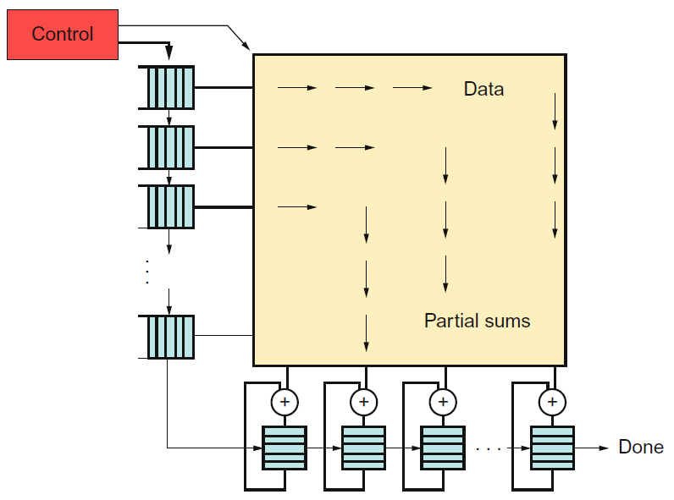
Systolic data flow of the Matrix Multiply Unit.

Slide 53
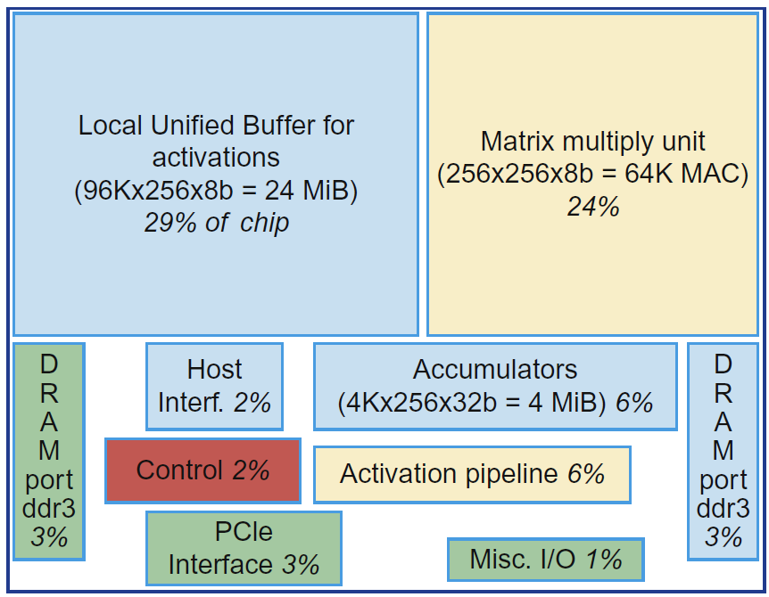
Floor plan of TPU die

Slide 54
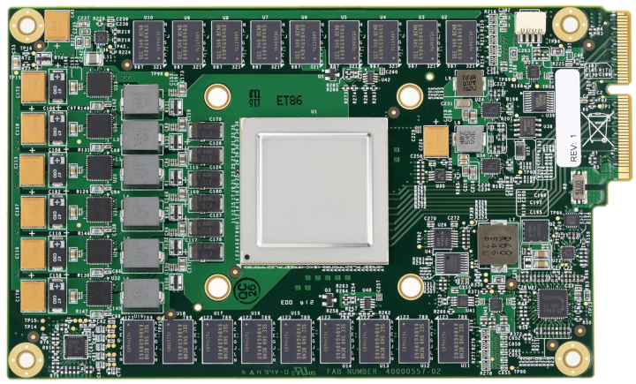
TPU printed circuit board
TPU inserted into the slot for an SATA disk
in a server, but the card uses the PCIe bus.

Slide 55
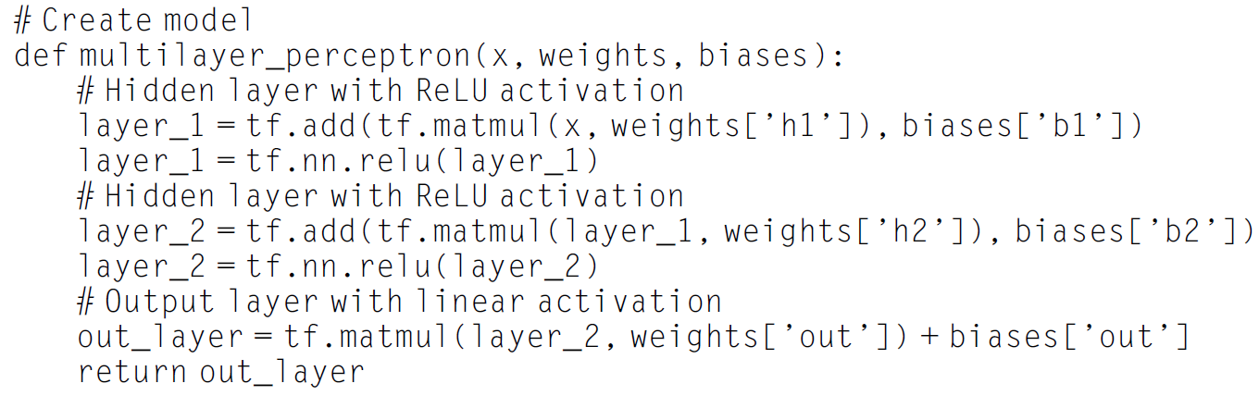

Slide 56
